Slide 1
Network Security
National Taiwan University
of Science and Technology

Slide 2
Classification
分類技術

Slide 3
Classification
用預測標籤分類 (定義或非定義)
predict categorical class label (discrete or nominal )
依照資料的值來和屬性相同的資料做分類
classifies data (constructs a model) based on the training set and the values (class labels) in a classifying attribute and uses it in classifying new data

Slide 4
Classification – A two–step process(1)
Model construction (Model Building)
Describing a set predetermined class
Each sample is assumed to belong to a predefined class, as determined by the class label attribute.
The set of tuple used for model construction is training set.
The model is represented as classification rules, decision trees, or mathematical formulate.

Slide 5
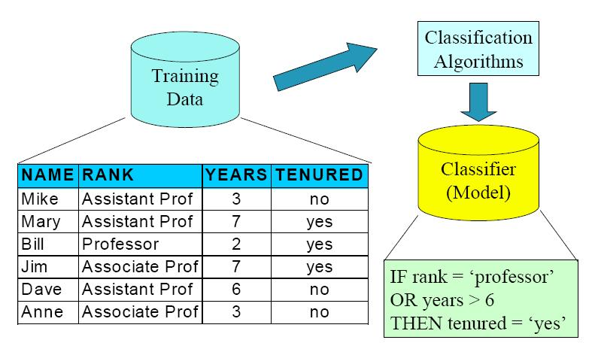
Model construction (Model Building)

Slide 6
Classification – A two–step process(2)
Model usage (Model Evaluation)
For classifying future or unknown objects
Estimate accuracy of the model
  The known label of test sample is compared with the classified result from the model.
  Accuracy rate is the percentage of test set sample that are correctly classified by the model.
  Test set is independent of training set, otherwise over-fitting will occur.
If the accuracy is acceptable, use the model to classify data tuple whose class are not known.

Slide 7
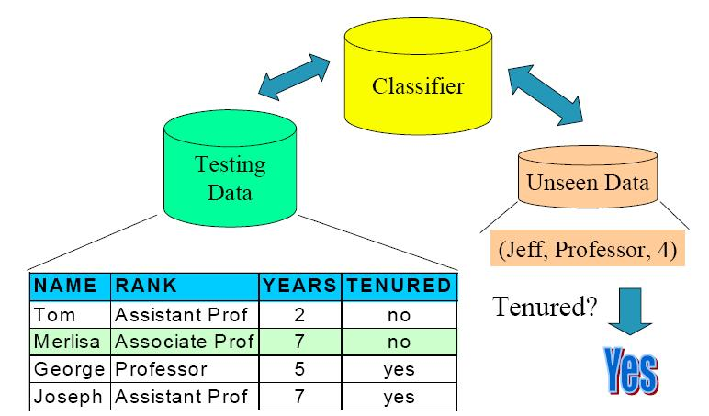
Model usage (Model Evaluation)

Slide 8
分類的技術- Supervised Learning
Supervised Learning (監督式學習法)- 決策樹
  The training data are accompanied by labels indicating the class of observation
  New data is classified based on training set.

Slide 9
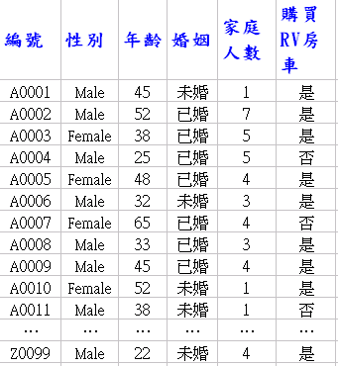
分類的技術- Supervised Learning
資料庫
分類標記
性別
Female
Male
年齡
婚姻
<35
≧35
未婚
已婚
否
是
否
是

Slide 10
分類的技術- Unsupervised Learning
Unsupervised Learning(非監督式學習法)- 分群分析
  The class label of training data is unknown.
  Given a set of measurement, observation, etc. with the aim of establishing the existence of classes or clusters in data.

Slide 11
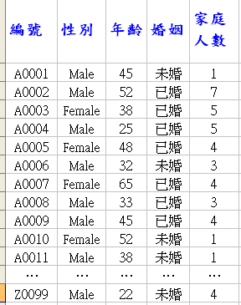
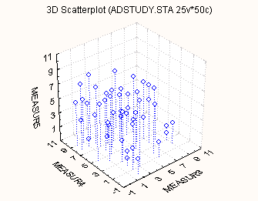
分類的技術- Unsupervised Learning http://gis.ascc.net/soda/images/classify.pdf
Male, year <35
Form a group
Measure: How many have car?

Slide 12
分類方法的評估
準確度
  分類準確: predicting class label
  預測準確: guessing value of predicted attributes
速度
  Time to construct the model (training time)
  Time to use model (classification time)
健全: 是否可以處理錯誤和遺失的資料
可詮釋的: understanding and insight provided by the model. Man’s age+Woman’s age>70
->tenured!

Slide 13
Decision Tree Induction
決策樹最主要由三個重要的元素所組成：節點（decision node）、分支（branch）、葉節點（leaf）。每個節點表示在某一個屬
性上的測試，每個葉節點則表示一個測試結果，即想要分類的類別（class），而分支則代表每個屬性的可能值的範圍。

Slide 14
決策樹(Decision Tree )介紹
根部節點(root node)
中間節點(non-leaf node)
(代表測試的條件)
分支(branches)
(代表測試的結果)
葉節點(leaf node)
(代表分類後所獲得的分類標記)

Slide 15
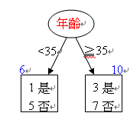
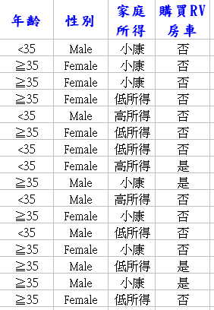
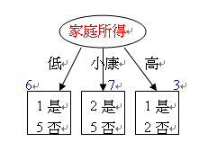
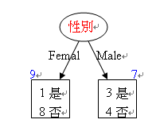
決策樹的形成 http://zh.wikipedia.org/wiki/%E5%86%B3%E7%AD%96%E6%A0%91
根部節點
中間節點
停止分支

Slide 16
Decision Tree Algorithm
在給定一組訓練資料，它會選擇最適當的屬性值並將每筆訓練資料於葉節點中被分類，為了要產生決策樹必須先選擇最適合的根節點，重複計算依序由上而下產生其他的節點，最後在葉節點中被正確的分類。很多演算法已經被發展出來建構更好更有效率的演算法。Quinlan 的ID3 和C4.5、Breiman andal.的CART。

Slide 17
Decision Tree Algorithm- ID3(C4.0/5.0)
Select the attribute with the highest information gain.
Let pi be the probability that an arbitrary tuple in D belongs to class Ci, estimated by |Ci, D|/|D|

Slide 18



Decision Tree Algorithm- ID3(C4.0/5.0)
Expected information (entropy) needed to classify a tuple in D:
Information needed (after using A to split D into v partitions) to classify D:
Information gained by branching on attribute A :

Slide 19
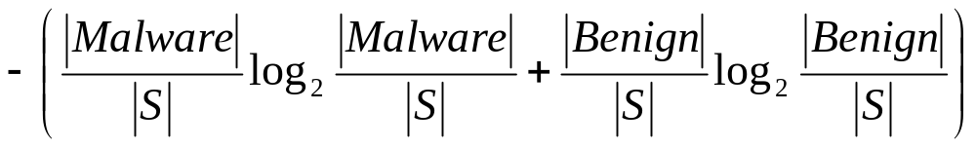
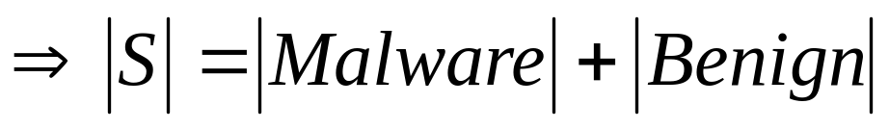
Example
假如在一個集合S裡有K個類別，, 是第i個類別在S集合裡的比例。很明顯的這裡的Info(S)是同等於S的Entropy(熵)。在我們的例子裡Info(S)應該是同等於下面的方式

Slide 20

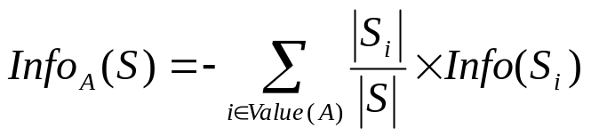

Information Gain
計算某一特徵A的entropy，Value A可為1或0分別代表該特徵出現與否：
Si是S的子集，為特徵A的值

Slide 21
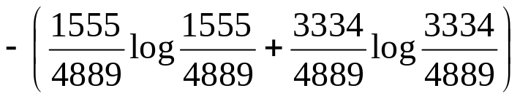
正常程式：1555 惡意程式：3334 →總數4889
某一特徵A在正常裡出現200次，惡意程式裡出現250次，所以它的information 為
它的 information gain 為
1555
3334
200
250
A出現

Slide 22
Decision Tree Algorithm-
Other Algorithm (C4.5)
Information gain measure is biased towards attributes with a large number of values
C 4.5 algorithm
  uses gain ratio to overcome the problem (normalization to information gain)
  The attribute with the maximum gain ratio is selected as the splitting attribute

Slide 23
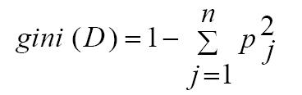
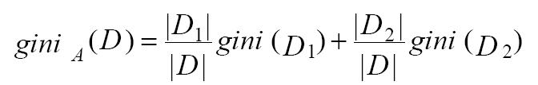
Decision Tree Algorithm-
Other Algorithm (Gini index)
If a data set D contains examples from n classes, gini index, gini(D) is defined as
If a data set D is split on A into two subsets D1 and D2, the gini index gini(D) is defined as

Slide 24


Decision Tree Algorithm-
Other Algorithm (Gini index)
Reduction in Impurity:
The attribute provides the smallest
(or the largest reduction in impurity) is chosen to split the node
Consider a binary split for each attribute: need to enumerate all the possible splitting points for each attribute

Slide 25
Decision Tree Algorithm-
Other Algorithm (CART)
由Friedman等人提出，1980年代以來就開始發展，是基於樹結構產生分類和迴歸模型的過程，是一種產生二元樹的技術。
CART與C4.5/C5.0演算法的最大相異之處是其在每一個節點上都是採用二分法，也就是一次只能夠有兩個子節點，C4.5/5.0則在每一個節點上可以產生不同數量的分枝。
CART模型適用於目標變數為連續型和類別型的變數，如果目標變數是類別型變數，則可以使用分類樹（classification trees），目標變數是連續型的，則可以採用迴歸樹（regression trees）。

Slide 26
Decision Tree Algorithm-
Other Algorithm(CHAID)
Perreault和Barksdale兩人於1980年提出CHAID（Chi-square automatic interaction detector）分析方法，CHAID是由AID演變而來的。
CHAID會防止資料被過度套用並讓決策樹停止繼續分割，依據的衡量標準是計算節點中類別的P值大小，以此決定決策樹是否繼續分割，所以不需要作樹剪枝。

Slide 27
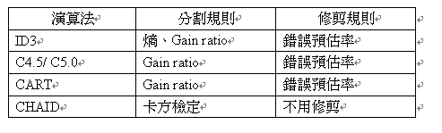
Decision Tree Algorithm-
Other Algorithm(Compare)

Slide 28
NaïveBayes Classification
Naïve Bayes 分類法是根據統計學上的貝氏定理（Bayes Theorem）衍生而來的，因為Naïve Bayes 的分類正確率並沒有如C4.5和SVM 那樣高，在分類的領域上常常被用來與其他演算法做比較。

Slide 29
NaïveBayes Classification
單純貝氏分類器 (Naïve Bayes Classifier) 是一種簡單且實用的分類方法。
在某些領域的應用上，其分類效果優於類神經網路和決策樹
採用監督式的學習方式，分類前必須事先知道分類型態，透過訓練樣本的訓練學習，有效地處理未來欲分類的資料。
用於大型資料庫，可以得出準確高且有效率的分類結果
單純貝氏分類器主要是根據貝氏定理 (Bayesian Theorem) ，來預測分類的結果。

Slide 30
NaïveBayes Classification
Advantages
  Easy to implement
  Good results obtained in most of the cases
Disadvantages
  Assumption: class conditional independence, therefore loss of accuracy
  Practically, dependencies exist among variables

Slide 31
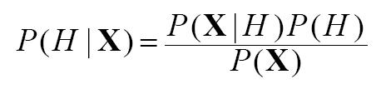
Bayes Theorem
Bayes Theorm:
  Let X is a data sample whose class label is unknown
  Let H be a class label
  P(H) is the prior probability of H
  P(H|X) is the posterior probability of H conditioned on X
  Example
    X: a red and round object
    C: being an apple or an orange
    H: being an apple (H ⊂ C)

